Slide 1


DATA ANALYSIS
CARS 24 SALES

Slide 2

Agenda
01
02
03
04
05
Total Sales Analysis
Citywise Sales Analysis
Problem
Dataset
Process

Slide 3
Develop a comprehensive data analysis framework to uncover insights and patterns in car sales data, aiming to optimize sales strategies, forecast demand, identify market trends, and enhance overall business performance within the automotive industry.
PROBLEM

Slide 4
Consists of 11 columns and 6678 entries
Columns:
Name
Company
Location
Year
Kilometers Driven
Fuel type
Transmission
Owner type
Mileage
Engine
Seats
Price
DATASET

Slide 5
DATA UNDERSTANDING
DATA CLEANING
PROCESS
DATA PROCESSING
DATA ANALYSIS
UNCOVERING THE INSIGHTS

Slide 6
ANALYSIS
Uncovering the Insights

Slide 7
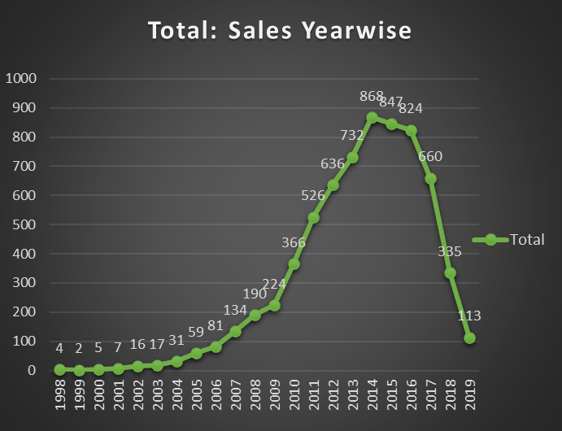
Total Yearwise Sales
Total Units Sold
6677
Year with most sales
2014
Year with least sales
1999
Steady increase since 2005
Significant decline after 2016

Slide 8
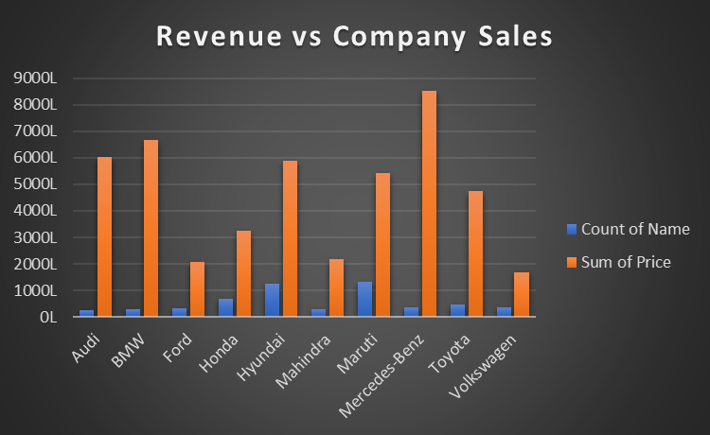
Revenue vs Company Sales
Company with most revenue
Mercedes-Benz
(85.25Cr)
Company with least revenue
Volkswagen
(16.72Cr)

Slide 9
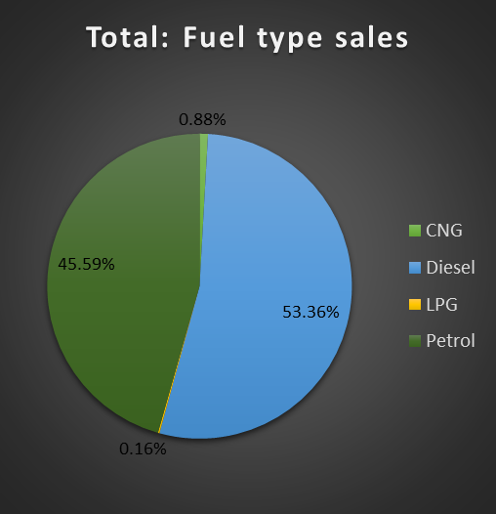
Total Fueltype sales
Diesel units
53.36%
(3563 units)
Petrol units
45.59%
(3044 units)
CNG units
0.88%
(59 units)
LPG units
0.16%
(11 units)

Slide 10
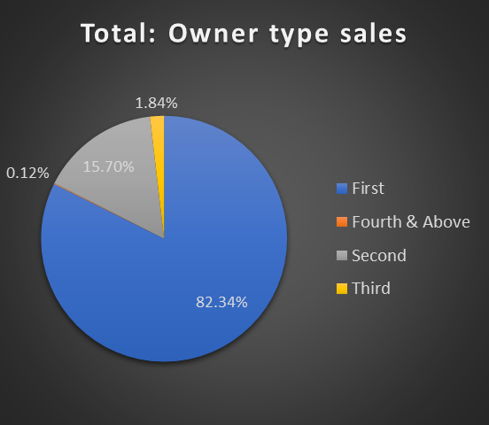
Total Owner type sales
First hand
82.34%
(5498 units)
Second hand
15.70%
(1048 units)
Third hand
1.84%
(123 units)
fourth & above
0.12%
(8 units)

Slide 11
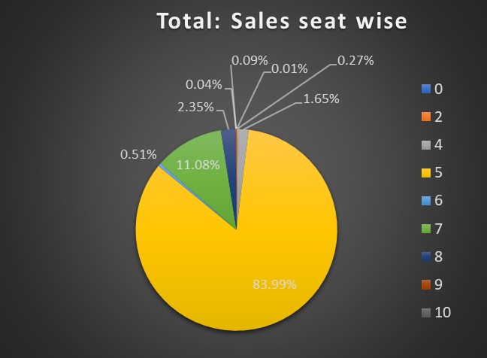
Total sales (No.of seats)
5 seater
83.99%
7 seater
11.08%
8 seater
2.35%

Slide 12
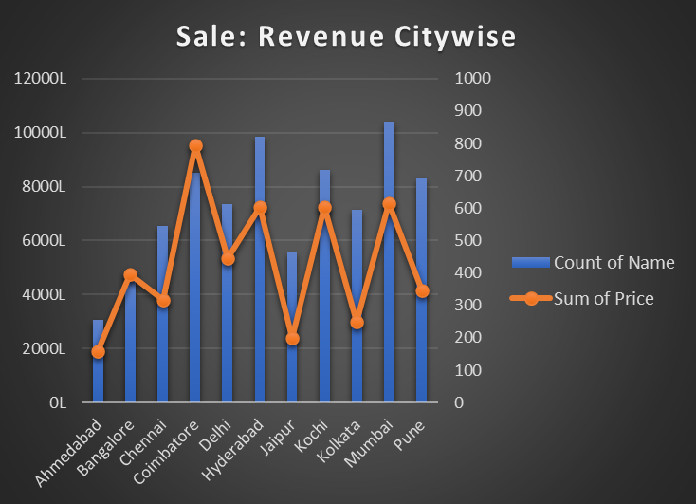
Sales & Revenue Citywise
Total Revenue
567.72 Cr
Most revenue
Coimbatore
95.47 Cr
(708 units)
Least revenue
Ahmedabad
18.9 Cr
(256 units)
Most Sales
Mumbai
(865 units)
Least Sales
Ahmedabad
(256 units)

Slide 13
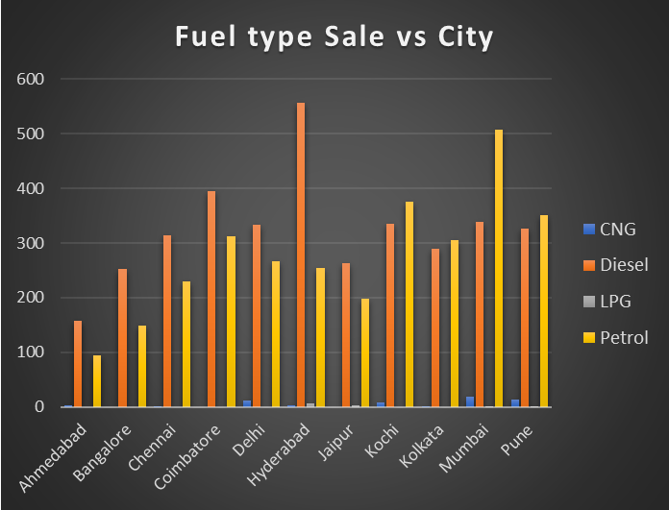
Fuel type Sales vs City
Diesel
Most: Hyderabad (556)
Least: Ahemedabad (158)
Petrol
Most: Mumbai (508)
Least: Ahemedabad (95)

Slide 14
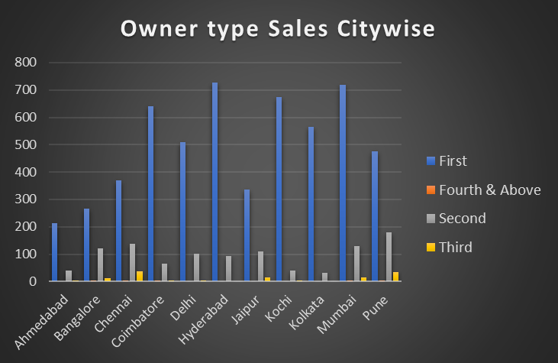
Owner type Sales vs City
First Hand
Most: Hyderabad (728),
Mumbai (719)
Least: Ahemedabad (214)
Second Hand
Most: Pune (180),
Least: Kolkata (32)
Third Hand
Most: Chennai (37), Pune (34)
Least: Hyderabad, Kolkata (0)

Slide 15
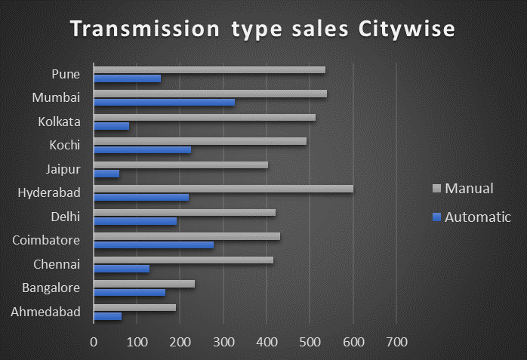
Transmission type Sales vs City
Manual
Most: Hyderabad (600)
Least: Ahmedabad (191)
Automatic
Most: Mumbai (326)
Least: Jaipur (60)

Slide 16

Thank You

